Slide 1
OSI Model & TCP/IP
Course Instructor:
Faraz Ali

Slide 2
Out Line
Introduction OSI
OSI History
OSI Layers
Introduction TCP/IP
TCP/IP Layers
Layering Considered Harmful?

Slide 3
Introduction OSI
The Open System Interconnection Reference Model (OSI Reference Model or OSI Model) is an abstract description for layered communications and computer network protocol design.
It divides network architecture into seven layers which, from top to bottom, are the Application, Presentation, Session, Transport, Network, Data Link, and Physical Layers. It is therefore often referred to as the OSI Seven Layer Model.

Slide 4
OSI History
In 1978, the International Standars Organization (ISO) began to develop its OSI framework architecture.
OSI has two major components: an abstract model of networking, called the Basic Reference Model or seven-layer model, and a set of specific protocols.

Slide 5
OSI History
The concept of a 7 layer model was provided by the work of Charles Bachman, then of Honeywell.
Various aspects of OSI design evolved from experiences with the Advanced Research Projects Agency Network (ARPANET) and the fledgling Internet.

Slide 6
OSI Layers
OSI Model
 | Data unit | Layer | Function
Host layers | Data | 7. Application | Network process to application
 |  | 6. Presentation | Data representation, encryption and decryption
 |  | 5. Session | Interhost communication
 | Segments | 4. Transport | End-to-end connections and reliability, Flow control
Media layers | Packet | 3. Network | Path determination and logical addressing
 | Frame | 2. Data Link | Physical addressing
 | Bit | 1. Physical | Media, signal and binary transmission
Going from layer 1 to 7: Please Do Not Throw Sausage Pizza Away
Going from layer 7 to 1: All People Seem To Need Data Processing

Slide 7
Layer1: Physical Layer
The Physical Layer defines the electrical and physical specifications for devices. In particular, it defines the relationship between a device and a physical medium.
This includes the layout of pin, voltages, cable specification, hubs, repeaters, network adapters, host bus adapters, and more.
Notes:
network adapters, host bus adapters, and more.

Slide 8
Layer1: Physical Layer
The major functions and services performed by the Physical Layer are:
  Establishment and termination of a connection to a communication medium.
  Participation in the process whereby the communication resources are effectively shared among multiple users. For example, flow control.
  Modulation, or conversion between the representation of digital data in user equipment and the corresponding signals transmitted over a communications channel. These are signals operating over the physical cabling (such as copper and optical fiber) or over a radio link.
Notes:
Establishment and termination of a connection to a communications medium.

Slide 9
Layer1: Physical Layer con.
The same applies to local-area networks, such as Ethernet, token ring ,
FDDI(Fiber Distributed Data Interface),
ITU-T( International Telecommunication Union Telecommunication Standardization Sector) G.hn and IEEE802.1I.
Personal area networks such as Bluetooth and IEEE 802.15.4.

Slide 10
Layer 2: Data Link Layer
The Data Link Layer provides the functional and procedural means to transfer data between network entities and to detect and possibly correct errors that may occur in the Physical Layer.
Originally, this layer was intended for point-to-point and point-to-multipoint media, characteristic of wide area media in the telephone system.
The data link layer is divided into two sub-layers by IEEE.

Slide 11
Layer 2: Data Link Layer
One is Media Access Control (MAC) and another is Logical Link Control (LLC).
Mac is lower sub-layer, and it defines the way about the media access transfer, such as CSMA/CD/CA(Carrier Sense Multiple Access/Collision Detection/Collision Avoidance)
LLC provides data transmission method in different network. It will re-package date and add a new header.

Slide 12
Layer 3: Network Layer
The Network Layer provides the functional and procedural means of transferring variable length data sequences from a source to a destination via one or more networks, while maintaining the quality of service requested by the Transport Layer.

Slide 13
Layer 3: Network Layer
The Network Layer performs
  network routing functions,
  perform fragmentation and reassembly,
  report delivery errors.
Routers operate at this layer—sending data throughout the extended network and making the Internet possible.

Slide 14
Layer 4: Transport Layer
The Transport Layer provides transparent transfer of data between end users, providing reliable data transfer services to the upper layers.
The Transport Layer controls the reliability of a given link through flow control, segmentation/desegmentation, and error control.

Slide 15
Layer 4: Transport Layer
Feature Name | TP0 | TP1 | TP2 | TP3 | TP4
Connection oriented network | Yes | Yes | Yes | Yes | Yes
Connectionless network | No | No | No | No | Yes
Concatenation and separation | No | Yes | Yes | Yes | Yes
Segmentation and reassembly | Yes | Yes | Yes | Yes | Yes
Error Recovery | No | Yes | No | Yes | Yes
Reinitiate connection (if an excessive number of PDUs are unacknowledged) | No | Yes | No | Yes | No
multiplexing and demultiplexing over a single virtual circuit | No | No | Yes | Yes | Yes
Explicit flow control | No | No | Yes | Yes | Yes
Retransmission on timeout | No | No | No | No | Yes
Reliable Transport Service | No | Yes | No | Yes | Yes

Slide 16
Layer 5: Session Layer
The Session Layer controls the dialogues (connections) between computers.
It establishes, manages and terminates the connections between the local and remote application.
It provides for full-duplex, half-duplex, or simplex operation, and establishes checkpointing, adjournment, termination, and restart procedures.

Slide 17
Layer 5: Session Layer
The OSI model made this layer responsible for graceful close of sessions, which is a property of the Transmission Control Protocol, and also for session check pointing and recovery, which is not usually used in the Internet Protocol Suite. The Session Layer is commonly implemented explicitly in application environments that use remote procedure calls.

Slide 18
Layer 6: Presentation Layer
The Presentation Layer establishes a context between Application Layer entities, in which the higher-layer entities can use different syntax and semantics, as long as the presentation service understands both and the mapping between them.
This layer provides independence from differences in data representation (e.g., encryption) by translating from application to network format, and vice versa.
This layer formats and encrypts data to be sent across a network, providing freedom from compatibility problems.
It is sometimes called the syntax layer.

Slide 19
Layer 7: Application Layer
The application layer is the OSI layer closest to the end user, which means that both the OSI application layer and the user interact directly with the software application.
Application layer functions typically include:
  identifying communication partners,
  determining resource availability,
  synchronizing communication.

Slide 20
Layer 7: Application Layer
Identifying communication partners
  Determines the identity and availability of communication partners for an application with data to transmit.
Determining resource availability
  Decide whether sufficient network or the requested communication exist.
Synchronizing communication
  All communication between applications requires cooperation that is managed by the application layer.

Slide 21
Layer 7: Application Layer
Some examples of application layer implementations include
  Hypertext Transfer Protocol (HTTP)
  File Transfer Protocol (FTP)
  Simple Mail Transfer Protocol (SMTP)

Slide 22
OSI Feature
Open system standards over the world
Rigorously defined structured, hierarchical network model
Complete description of the function
Provide standard test procedures

Slide 23
Introduction TCP/IP
The Internet Protocol Suite (commonly known as TCP/IP) is the set of communications protocols used for the Internet and other similar networks.
It is named from two of the most important protocols in it:
  the Transmission Control Protocol (TCP) and
  the Internet Protocol (IP), which were the first two networking protocols defined in this standard.

Slide 24
TCP/IP Layers
OSI | TCP/IP
Application Layer | Application Layer TELNET, FTP, SMTP, POP3, SNMP, NNTP, DNS,NIS, NFS, HTTP, ...
Presentation Layer
Session Layer
Transport Layer | Transport Layer TCP , UDP , ...
Network Layer | Internet Layer IP , ICMP, ARP, RARP, ...
Data Link Layer | Link Layer FDDI, Ethernet, ISDN, X.25,...
Physical Layer

Slide 25
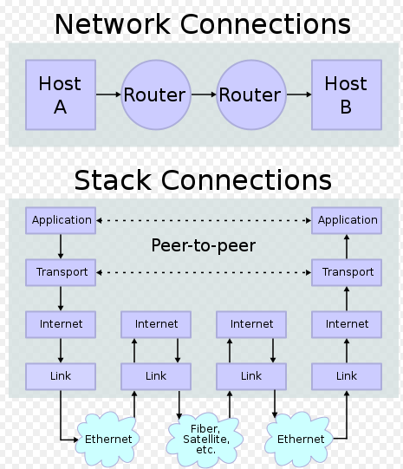
TCP/IP Stack

Slide 26
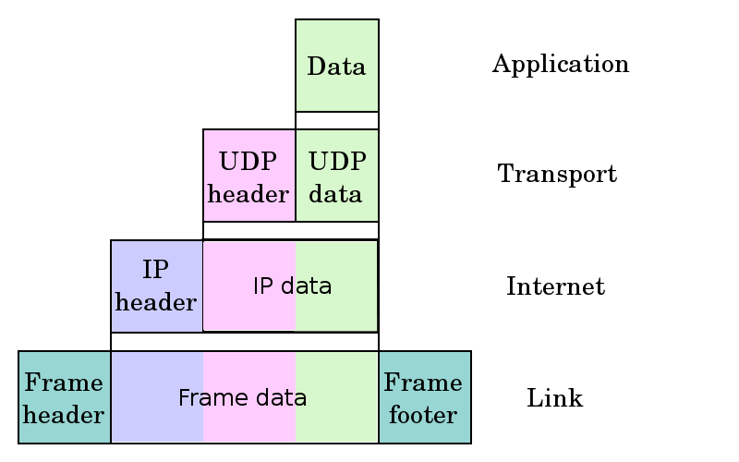
TCP/IP Encapsulation

Slide 27
TCP/IP Some Protocol
Layer | Protocol
Application | DNS, TFTP, TLS/SSL, FTP, Gopher, HTTP, IMAP, IRC, NNTP, POP3, SIP, SMTP, SMPP, SNMP, SSH, Telnet, Echo, RTP, PNRP, rlogin, ENRP
 | Routing protocols like BGP and RIP which run over TCP/UDP, may also be considered part of the Internet Layer.
Transport | TCP, UDP, DCCP, SCTP, IL, RUDP, RSVP
Internet | IP (IPv4, IPv6), ICMP, IGMP, and ICMPv6
 | OSPF for IPv4 was initially considered IP layer protocol since it runs per IP-subnet, but has been placed on the Link since RFC 2740.
Link | ARP, RARP, OSPF (IPv4/IPv6), IS-IS, NDP

Slide 28
Why Layering Considered Harmful?
In the data networking context structured layering implies that the functions of each layer are carried out completely before the protocol data unit is passed to the next layer.
This means that the optimization of each layer has to be done separately.
Such ordering constraints are in conflict with efficient implementation of data manipulation functions.

Slide 29
Why Layering Considered Harmful?
As a result of inter-layer dependencies, increased layering can quickly lead to violation of the Simplicity Principle.
Industry experience has taught us that increased layering frequently increases complexity and hence leads to increases in OPEX(Operating Expense), as is predicted by the Simplicity Principle.
It is always possible to agglutinate multiple separate problems into a single complex interdependent solution. In most cases this is a bad idea.

